Slide 1
ENGR90037 CAPSTONE
Scheduling and Cost
Week 3
Lecture 3 — Estimation, Dependencies and the Gantt Chart
Yimin & Bagus

Slide 2
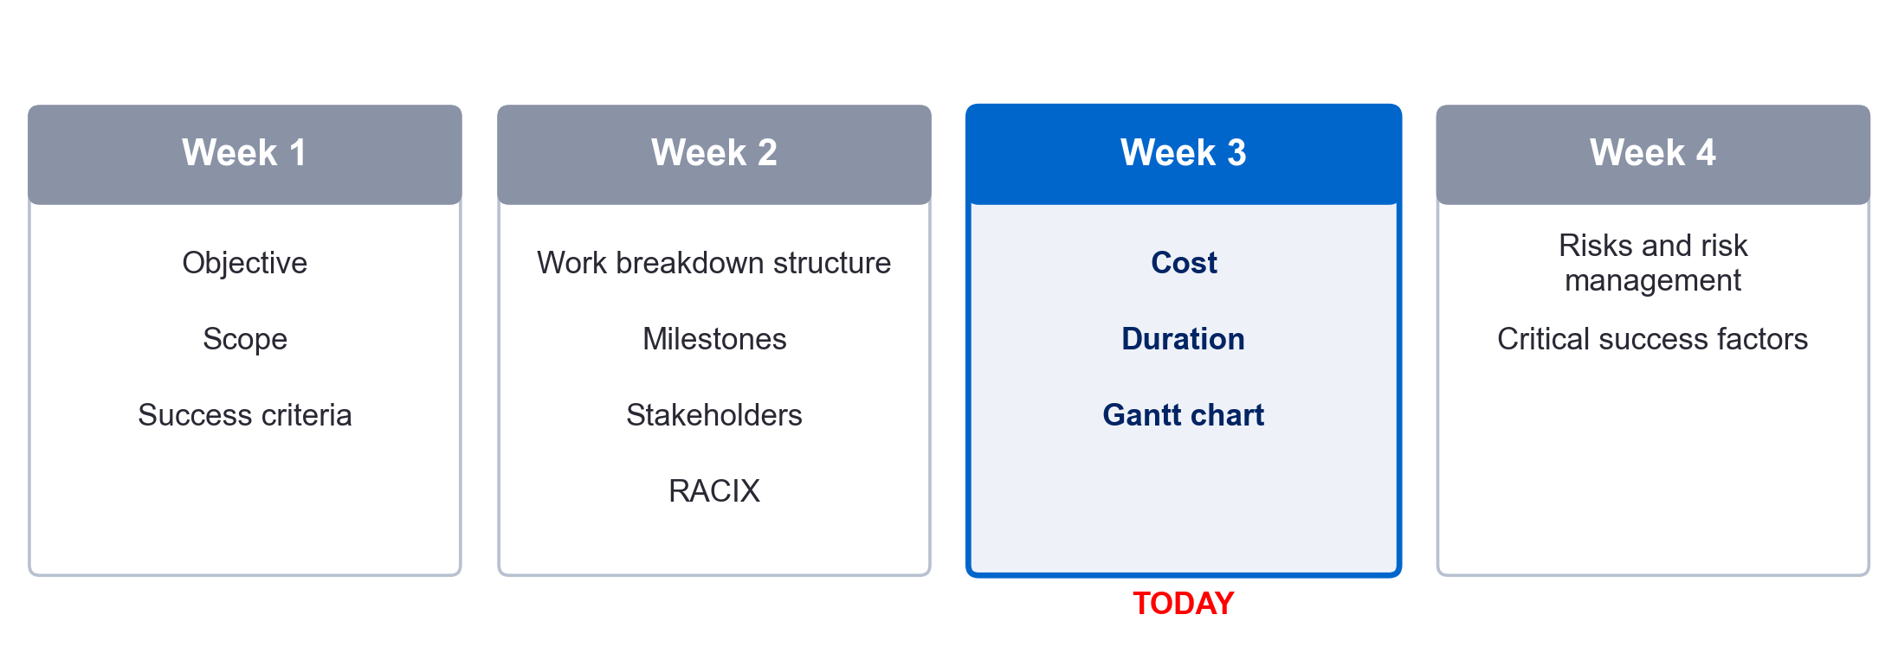
Learning Objectives
• Last week: WBS, Stakeholders and Milestones in your Charter
• This week: estimating, dependencies and critical path. Develop your Gantt chart
ENGR90037 Capstone · Lecture 3: Scheduling and Cost
1

Slide 3
Effort, duration and cost
Vocabulary
• Effort
• Also referred to as “Staff Days” or “Staff Weeks”
• The number of labour units required to complete a schedule activity.
• Often expressed in hours, days, or weeks
• Duration
• The total number of work periods required to complete an activity
• Expressed in hours, days, or weeks
• Cost
• Cost is calculated from the hourly charge-out rate of people multiplied by duration, plus direct expenses
ENGR90037 Capstone · Lecture 3: Scheduling and Cost
3

Slide 4
Estimating
Definition — A quantitative assessment of the likely amount or outcome of a variable, such as project costs, resources, effort, or durations. (PMBOK 2025.)
There are many different estimating methods:
• Top-down estimating: the starting point is when the project must finish, and that total is allocated down to tasks
Expert judgment: Expert judgment is judgment provided based upon expertise in an application area, discipline, industry, etc., as appropriate for the activity being performed.
Analogous estimating: based on historical data. Actual cost and time of a similar previous project
• Bottom-up estimating: estimate by aggregating the estimates of the lower-level components
of the work breakdown structure (WBS).
ENGR90037 Capstone · Lecture 3: Scheduling and Cost
4

Slide 5
§3 Cost — the budget estimate
Charter §3
• Forecast what resources the project will require, what quantities of each will be needed, when they will be needed, and how much they will cost.
• It is the estimated maximum you may spend before you would have to ask permission to exceed it
• Even if your project spends almost nothing, the people cost is real and must be counted
ENGR90037 Capstone · Lecture 3: Scheduling and Cost
5

Slide 6
The costing rules for your capstone
• What are the categories of your project?
• Student hours: $100 per hour. Supervisor and adviser hours: $200 per hour
• Example: 720 student hours (360 × 2 students) at $100 = $72,000
• Example: 48 supervisor hours at $200 = $9,600
• Equipment or software under $100 per item goes into one line called “Sundries”. Otherwise, list its name and cost
• You will get $800 for consumables by the faculty.
ENGR90037 Capstone · Lecture 3: Scheduling and Cost
6

Slide 7
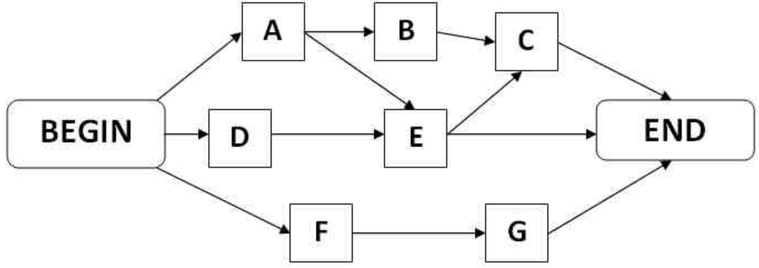
Project Network
• The project network is developed from the information collected from the WBS (Week 2) and is a graphic flow chart of the project job plan (Project Management: A Socio-technical Approach, 2024)
• Activity-on-node (AON) and activity-on-arrow (AOA) are two historical methods commonly used in project management.
• We will use the AON diagram just to illustrate and explain relevant concepts: dependency, critical path, float/slack.
• An AON diagram shows each task as a node and links the nodes with arrows that show their technological relationship.
Activity C
Activity A
Activity D
Activity B
Activity E
https://project-management-knowledge.com/definitions/a/activity-on-node/
7

Slide 8
Four types of dependencies
Finish-to-start (FS)
• Successor cannot begin until predecessor finishes.
• Example: Foundation must be built before the building structure.
Finish-to-finish (FF)
• Successor cannot finish before predecessor finishes.
• Example: Documenting cannot finish before the project finishes.
Finish to Start (FS)
Activity A
Activity B
Activity A
Finish to Finish (FF)
Activity B
ENGR90037 Capstone · Lecture 3: Scheduling and Cost
8

Slide 9
Four types of dependencies
Start-to-start (SS)
• Successor cannot start until predecessor starts.
• Example: Workers can start paving a road with asphalt as soon as the excavation crew starts clearing the dirt ahead of them.
Start-to-finish (SF)
• Successor cannot finish until predecessor starts.
• Example: The old system cannot shut down until the new system starts.
Activity A
Start-to-Start (SS)
Activity B
Start-to-Finish (SF)
Activity A
Activity B
ENGR90037 Capstone · Lecture 3: Scheduling and Cost
9

Slide 10
The critical path and float
• The longest chain of dependent tasks through the project
• If any task on the critical path is delayed, you delay the whole project
• It sets the shortest possible duration. You cannot finish sooner without changing the critical path
• Float is how much a task can slip without moving the end date
4 weeks
1 week
2 weeks
3 weeks
4 weeks
3 weeks
2 weeks
ENGR90037 Capstone · Lecture 3: Scheduling and Cost
10

Slide 11
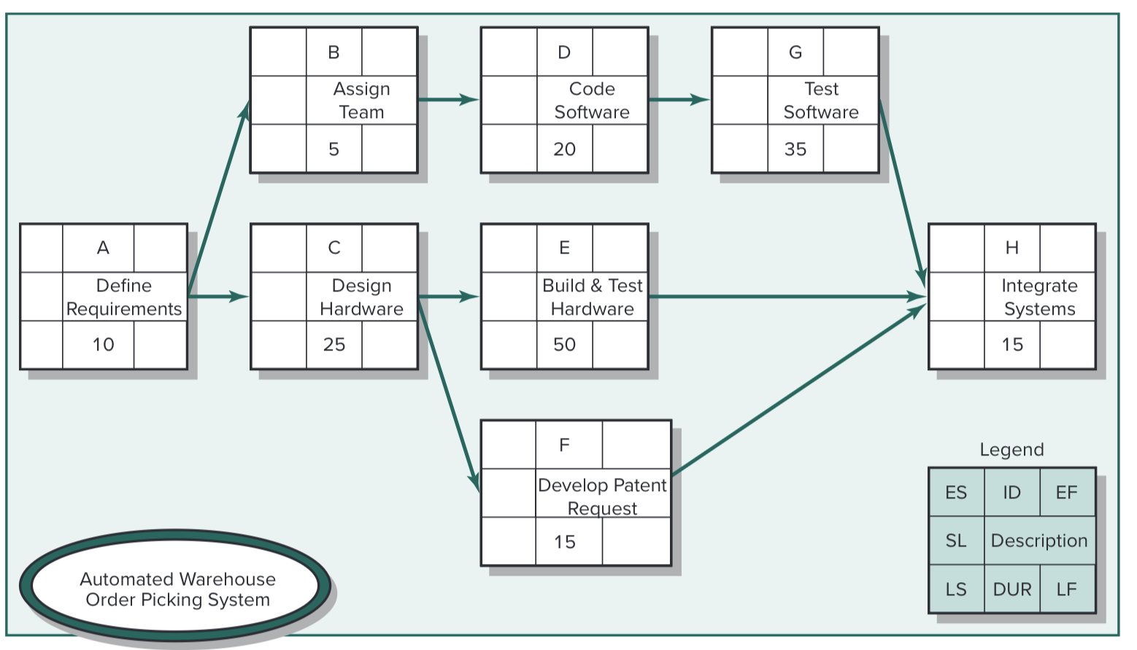
The critical path and float
• Now, with software such as MS Project, they calculate critical path and slack/float automatically.
• How do we calculate them by hand, especially when critical path is not obvious.
• Please check out the recorded session on Canvas.
ENGR90037 Capstone · Lecture 3: Scheduling and Cost
10
(Project Management: A Socio-technical Approach, 2024)

Slide 12
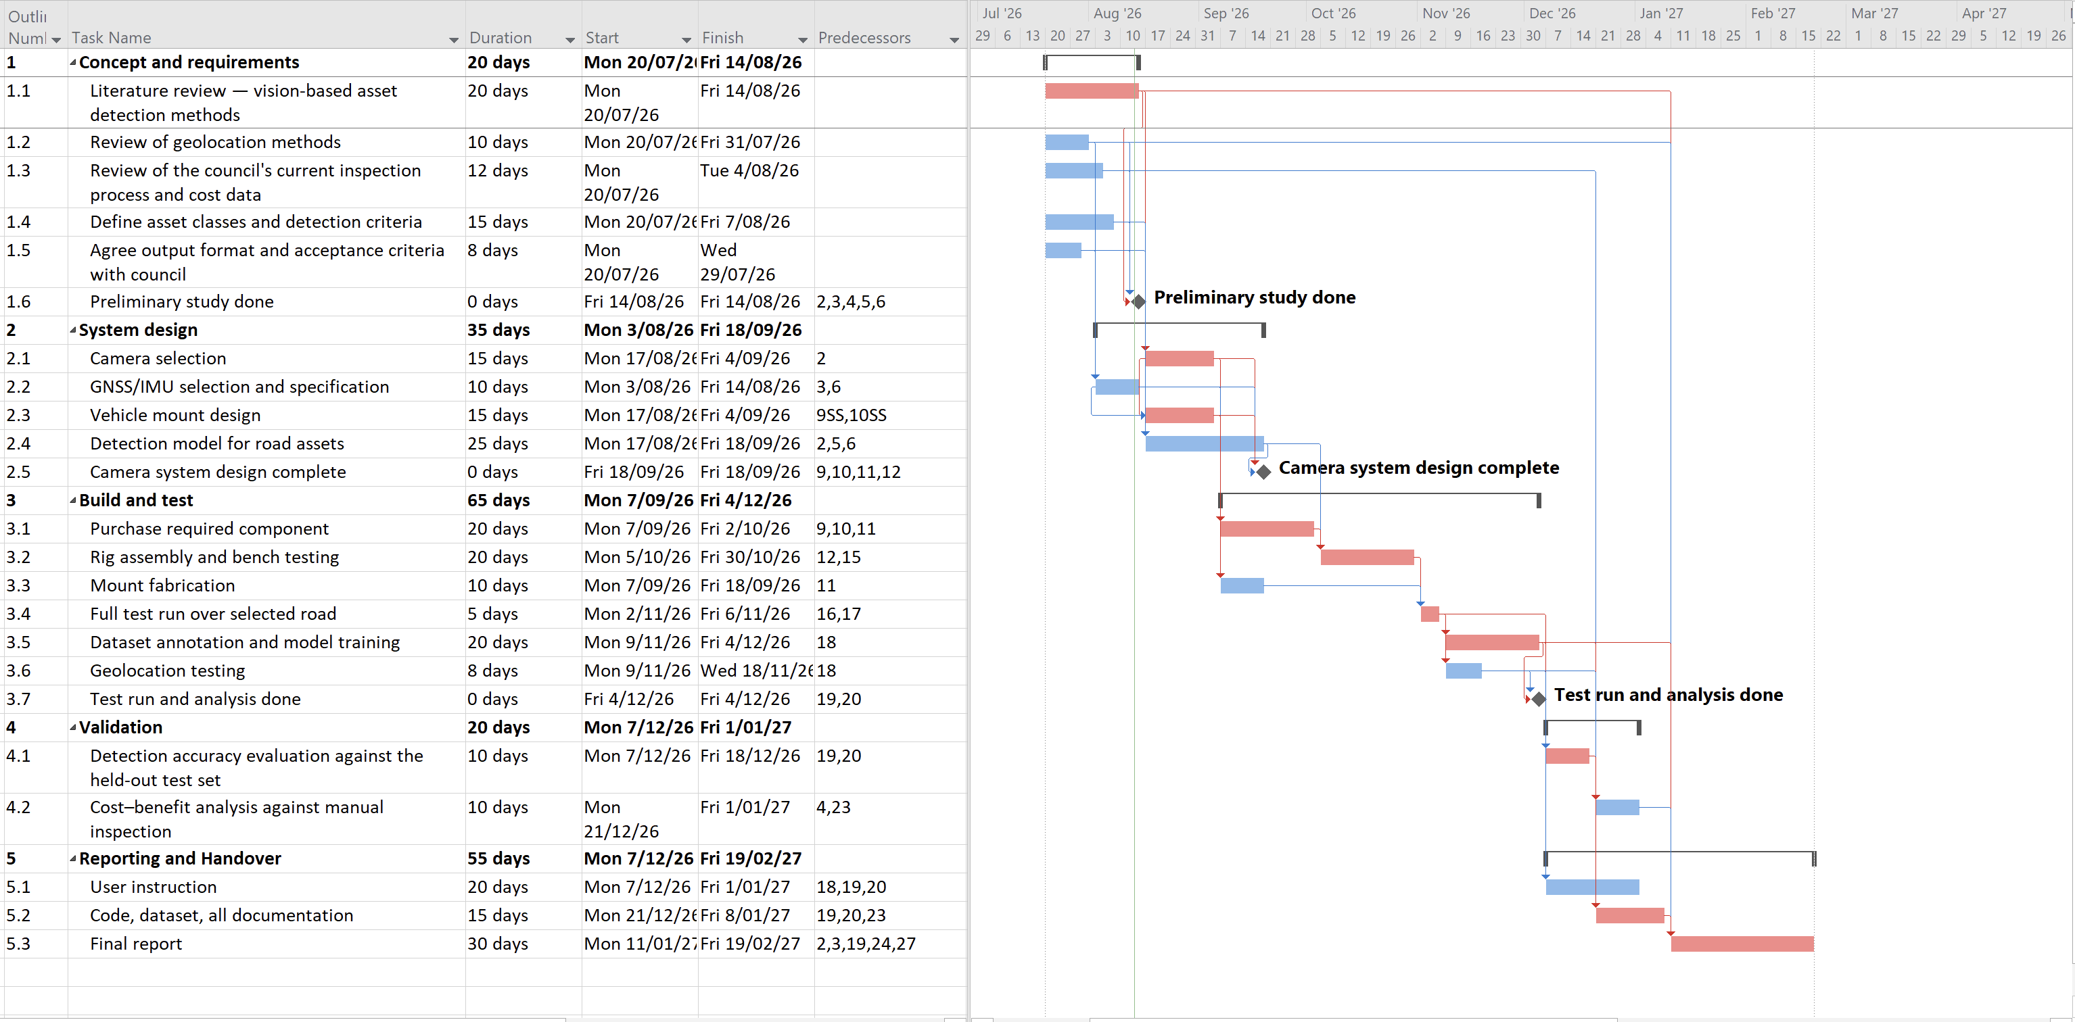
The Gantt chart
• Named after Henry Gantt, around 1910 — still the standard way to show a plan
• Time across the top, tasks down the side, bars for duration
ENGR90037 Capstone · Lecture 3: Scheduling and Cost
11

Slide 13
The Gantt chart — LIVE Demonstration
ENGR90037 Capstone · Lecture 3: Scheduling and Cost
12

Slide 14
Principles of scheduling
• Start every task immediately or sooner unless that is impossible
• Finish the project as soon as possible, without compromising quality or blowing the budget
• Do as many tasks concurrently as you can, but . . .
• Respect dependencies between tasks
ENGR90037 Capstone · Lecture 3: Scheduling and Cost
13

Slide 15
What your Gantt chart must show
• All tasks from your WBS
• Dependencies between tasks
• Start and finish dates for every task
• The critical path, clearly indicated
• Milestones as zero-duration tasks — diamonds by convention
• Every task planned to start as early as it can; if it does not start on day one, it needs a predecessor
ENGR90037 Capstone · Lecture 3: Scheduling and Cost
14

Slide 16
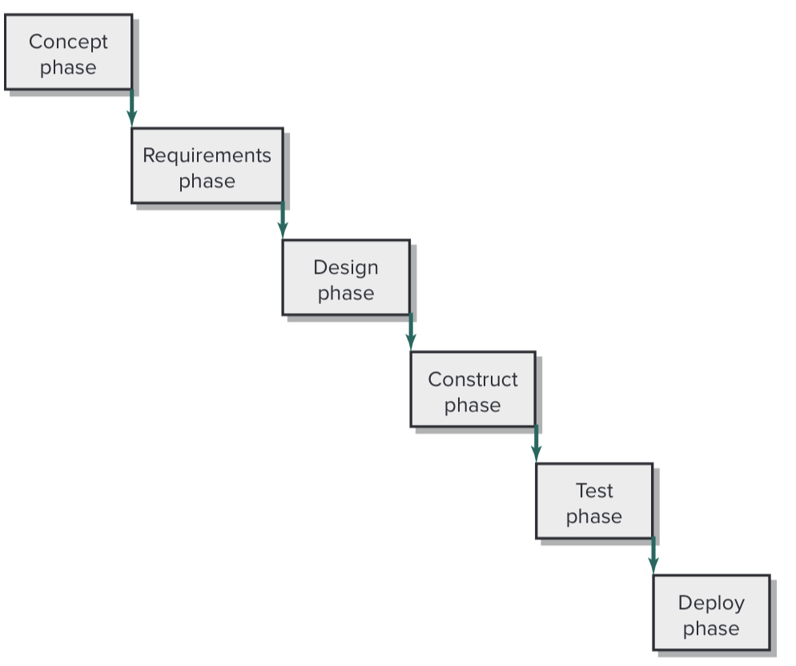
Different projects need different scheduling logic
• Predictive approaches:
  • Waterfall — specify, then build. Suits work you can define up front
  • Incremental — build in usable chunks, each adding capability
Project Management: A Socio-technical Approach, 2024)
ENGR90037 Capstone · Lecture 3: Scheduling and Cost
15

Slide 17
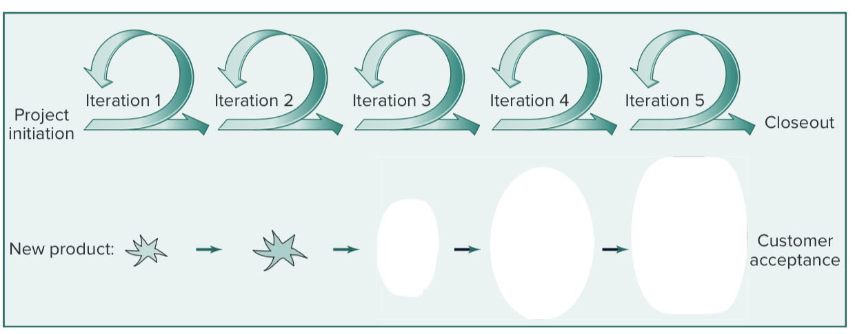
Different projects need different scheduling logic
• Iterative — build a version, evaluate, refine. Suits work where the answer emerges
• From delivery oriented to process oriented. What feedback you are trying to get from each iteration?
Project Management: A Socio-technical Approach, 2024)
ENGR90037 Capstone · Lecture 3: Scheduling and Cost
15

Slide 18
Choosing an approach for your project
• Two things to consider when choosing a suitable scheduling approach:
• First is the project itself:
Design and build — waterfall with a prototype increment. You can specify up front.
Simulation or machine learning — iterative. The model-run-compare cycle is your estimating unit. Each experiment sets the next question
• Second is how much you know about the project:
Scopes, expected workflow, results, etc…
There is no correct or wrong way to schedule your capstone project. See demonstration #2.
16

Slide 19
This week and next week
• Estimate effort, duration and cost for every task in your WBS
• Draft §3 Cost in your Charter — and check the arithmetic
• Build your Gantt chart, with the critical path marked
• Next week: what could go wrong, and what must go right
ENGR90037 Capstone · Lecture 3: Scheduling and Cost
17

